Slide 1
Image Caption Generator with
CNN and LSTM
Submitted By
Ghulam Abbas
Roll No: BSITF18E004,
Abubakar Siddique Khan
Roll No: BITF18E004,
CS&IT, SU
Submitted To
Sir. Fahad
Professor,
CS&IT, SU

Slide 2
What is Image Caption Generator?
Image caption generator is a task that involves computer vision and natural language processing concepts to recognize the context of an image and describe them in a natural language like English.

Slide 3
Image Caption Generator Model
1
CNN
2
LSTM

Slide 4
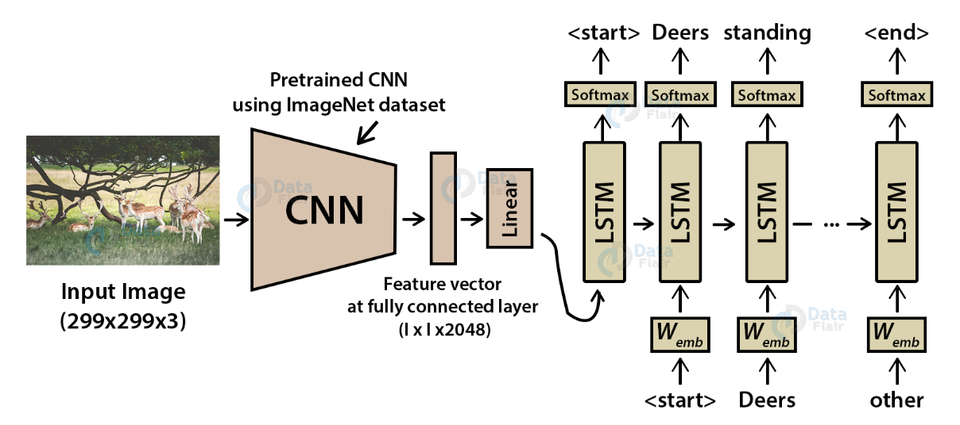
Image Caption Generator Model

Slide 5
What is CNN?
Convolutional Neural networks are specialized deep neural networks which can process the data that has input shape like a 2D matrix. Images are easily represented as a 2D matrix and CNN is very useful in working with images.

Slide 6
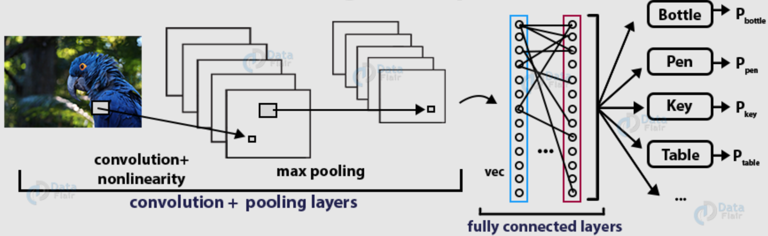
Working on deep CNN

Slide 7
What is LSTM?
LSTM stands for Long short term memory, they are a type of RNN, which is well suited for sequence prediction problems. LSTM can carry out relevant information throughout the processing of inputs and with a forget gate, it discards non-relevant information.

Slide 8
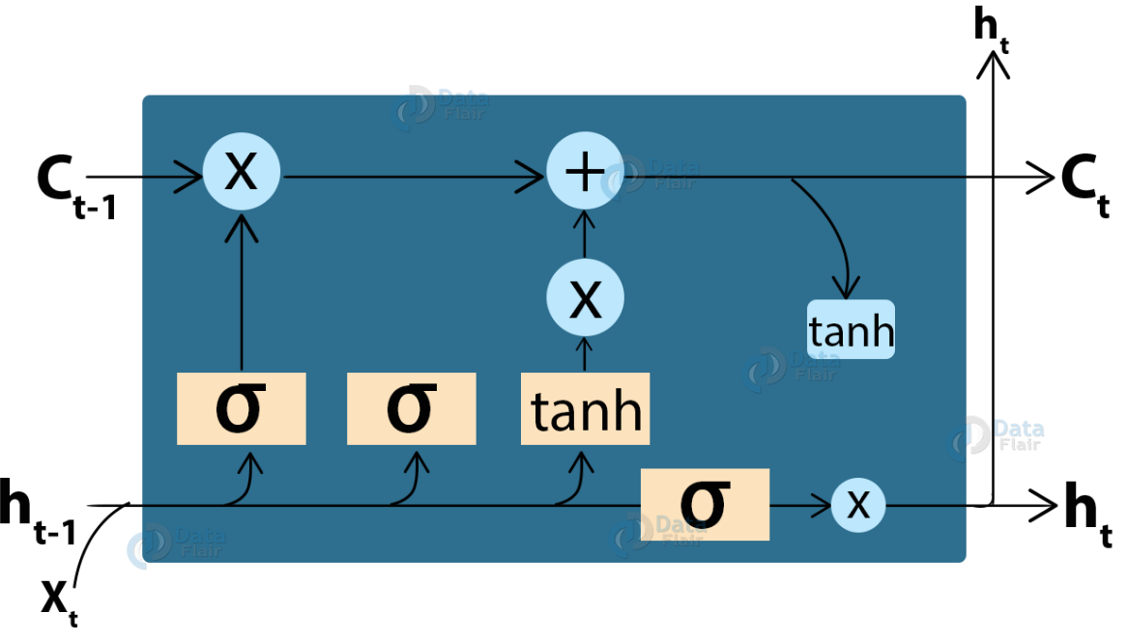
LSTM cell structure

Slide 9



Dataset
8000
6000
7577
Total
Train
Vocabulary size

Slide 10
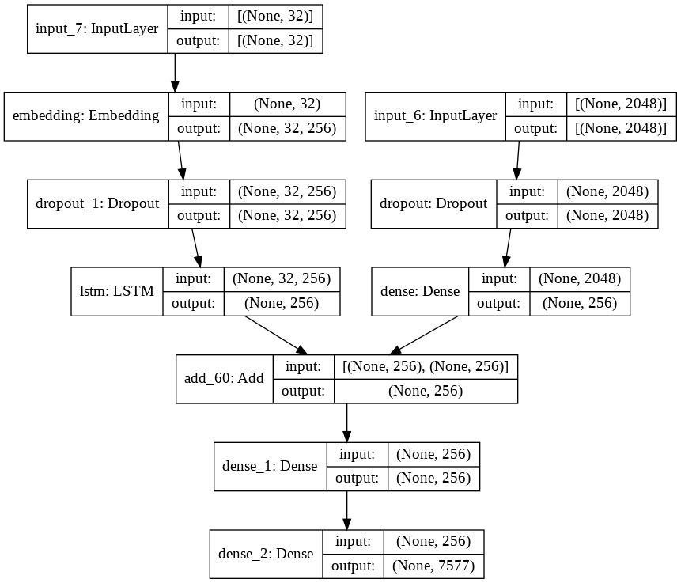
Visual representation of the final model

Slide 11
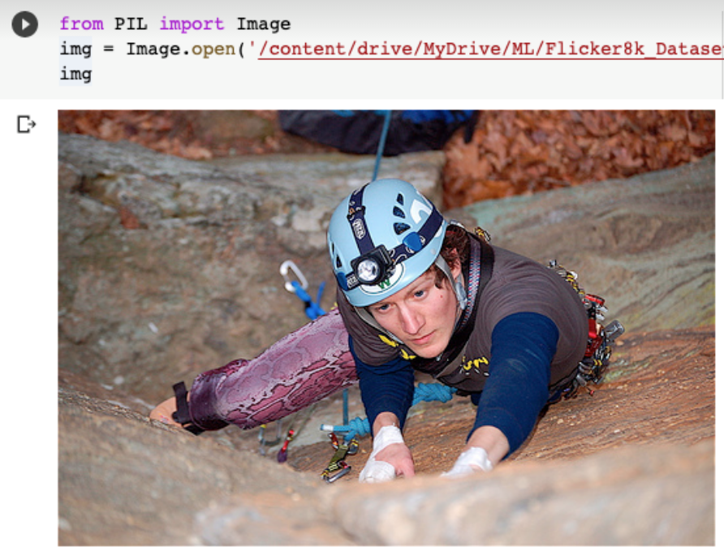
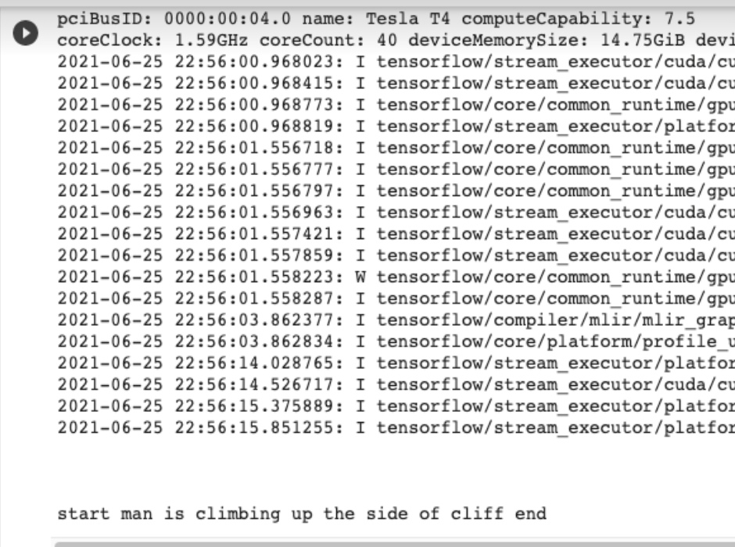
Result

Slide 12


